Slide 1

Module 3 –In Memory Computation
Getting started with Spark

Slide 2


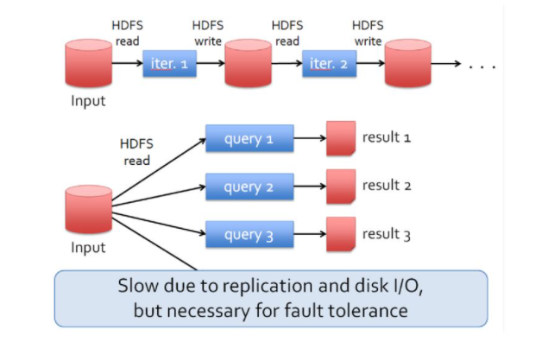
IN MEMORY COMPUTATION – Spark Introduction
Why Spark?
Faster than Hadoop- 100 times faster
Iterative Processing

Slide 3
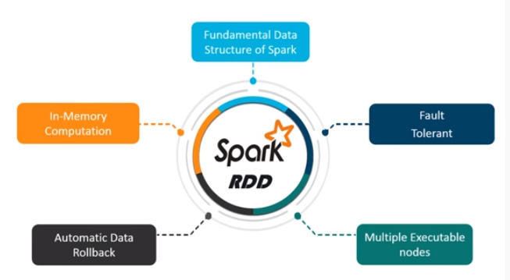
IN MEMORY COMPUTATION- Spark Introduction
How Spark is achieving this speed?- RDD
Resilient Distributed Dataset is the most fundamental data structure for Spark.
RDD is a distributed collection of memory
RDD’s are fault tolerant
RDD is better than Map reduce storage
Avoids all reading/writing to HDFS
Significantly reduces I/O operations
https://www.edureka.com

Slide 4
BIG DATA
What is an RDD?
When we add lineage information to the concept of a Distributed Dataset
We add ability to recreate it in case of failure
So, this data is now resilient to failures.
Hence called an RDD: Resilient Distributed Dataset

Slide 5
BIG DATA
How is lineage information stored
Lineage information is stored by keeping track of
Operations that are performed on
An RDD
That results in another RDD
What types of operations are supported?
Source
RDD
Operation
Destination
RDD

Slide 6
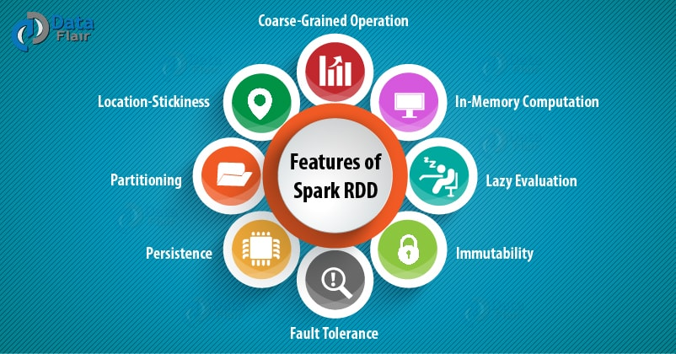
IN MEMORY COMPUTATION-Spark
Features of RDD

Slide 7
IN MEMORY COMPUTATION-Spark
How to create RDD?
From Parallelized Collections
From External Storage
From RDD

Slide 8
IN MEMORY COMPUTATION-Spark
PySpark
But Spark also support a python binding
Write code in python
With additional spark transformations/actions
Program runs as a Spark job
Supports the pyspark shell for interactive processing
And regular batch processing jobs can be run by writing pyspark scripts

Slide 9
BIG DATA
Pyspark configuration
Needs environment variables to be setup
First modify .bashrc to include
Then run so that the env variables are setup
export SPARK_HOME = /home/hadoop/spark-2.1.0-bin-hadoop2.7
export PATH = $PATH:/home/hadoop/spark-2.1.0-bin-hadoop2.7/bin
export PYTHONPATH = $SPARK_HOME/python:$SPARK_HOME/python/lib/py4j-0.10.4-src.zip:$PYTHONPATH
export PATH = $SPARK_HOME/python:$PATH
# source .bashrc

Slide 10
BIG DATA
Starting pyspark
Needs environment variables to be setup
First modify .bashrc to include
./bin/pyspark

Slide 11
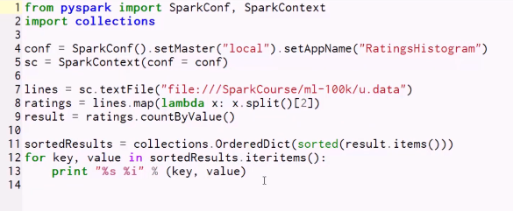
IN MEMORY COMPUTATION
First Spark Code

Slide 12

BIG DATA
Recall: The Spark Context
This is the master for your spark application.
Starting and stopping/cancelling a job.
Interacts with cluster manager like YARN
https://spark.apache.org/docs/latest/cluster-overview.html

Slide 13
BIG DATA
When is Spark Context created?
Programmatically : SparkContext.getOrCreate() from Spark v2
There is one SparkContext per JVM
Interactively: When you start spark-shell
https://spark.apache.org/docs/latest/cluster-overview.html

Slide 14
BIG DATA
py4j
Acts like a bridge between python and java
Allows python interpreter to access Java objects instantiated within the JVM
Can invoke methods on the Java objects as if they were python methods
https://www.py4j.org/

Slide 15
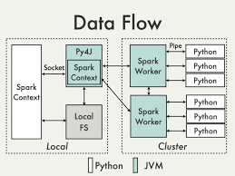
BIG DATA
Pyspark architecture
Python driver
Java SparkContext used to drive the application
Data has to be serialized using cPickle serializer
https://cwiki.apache.org/confluence/display/SPARK/PySpark+Internals

Slide 16
IN MEMORY COMPUTATION
Creation of RDD from parallelized collections
Scala
val data = Array(1, 2, 3, 4, 5)
val distData = sc.parallelize(data)
Python
data = [1, 2, 3, 4, 5]
distData = sc.parallelize(data)

Slide 17
IN MEMORY COMPUTATION
Creation of RDD from external storage
Scala
scala> val distFile = sc.textFile("data.txt")
Python
distFile = sc.textFile("data.txt")

Slide 18
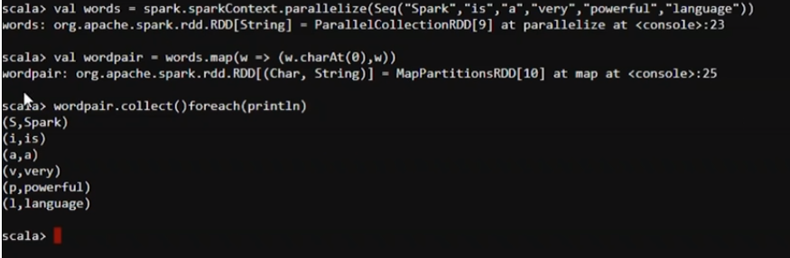
IN MEMORY COMPUTATION
Creation of RDD from RDD

Slide 19

IN MEMORY COMPUTATION
What’s new in Spark 3?
New Data Frame based ML lib
17 times faster than Spark 2
Python 2 deprecated
No Deep Learning feature
Support of GPU Instances
Kubernote Integration
Binary File
Spark Graph(CPR)
ACID on data lake

Slide 20
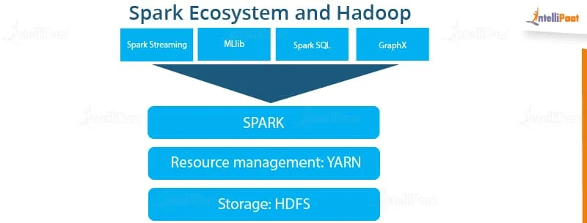
IN MEMORY COMPUTATION
Is Spark a complete replacement for Hadoop?
Own Server
ML Lib capabilities
No DFS

Slide 21
RDD Operations : Transformations and Actions
Notes:
Exercise
Write a similar program for
Finding the words in a file
For each word, calculate the count
Assume the file contains the string
“To be or not to be”
Hint
This should be done in parallel
In the blue boxes, read in each line in the file
If the line is w1 w2 w3 w4, then output 4 lines w1 1 w2 1 w3 1 w4 1

Slide 22
BIG DATA
Types of Operations
Operations are of two types
Transformations
Actions

Slide 23
BIG DATA
Transformation
Are operations that create a new dataset from an existing dataset
For example:
map() is a transformation
Each line on input RDD is passed through the map() function
result of map() function applied on each value is stored in the output RDD.
Note it is similar to the Map of map-reduce, but is more generic.

Slide 24
BIG DATA
Transformation- Map()
User id | Movie id | Ratings | Timestamp
196 | 242 | 3 | 8812
186 | 302 | 3 | 891
22 | 377 | 1 | 87
35 | 402 | 2 | 62
How many times each rating appears?

Slide 25
BIG DATA
Transformation- Map()
from pyspark import SparkConf, SparkContext
import collections
conf = SparkConf().setMaster("local").setAppName("RatingsHistogram")
sc = SparkContext(conf = conf)
lines = sc.textFile("file:///Spark/ml-100k/u.data")
ratings = lines.map(lambda x: x.split()[2])
result = ratings.countByValue()
sortedResults = collections.OrderedDict(sorted(result.items()))
for key, value in sortedResults.items():
print("%s %i" % (key, value))

Slide 26
THANK YOU

